Slide 1
UNICEF Club Meeting
12/14/18
Give Hope - HIV/AIDS & Nutrition
Officers: Sneha Gonuguntla, Smruti Shah, Sahil Gullapalli, Lauren Grant, and Aishu Rajubabu

Slide 2
Helping Children Fight HIV/AIDS
For the first time since the start of the epidemic, an AIDS-free generation is within reach.
67% of pregnant women in countries with the highest rate of infection receiving services in 2013.
UNICEF uses a multifaceted approach to stopping the epidemic including prevention, treatment, protection and care, as well as support for children and adolescents who are most at risk.
AIDS-related deaths among adolescents increased by 50% between 2005 and 2012.
HIV/AIDS is a leading cause of death for teens globally
In 2013, there were 240,000 new HIV infections among children in low- and middle-countries.

Slide 3
What is UNICEF Doing?
Prevention of mother-to-child-transmission (PMTCT) is the most effective way to create an HIV-free generation. UNICEF’s efforts to prevent this has made significant progress.
UNICEF estimates that, since 2000, 30 million new infections were prevented, nearly 8 million deaths averted, and 15 million people living with HIV are now receiving treatment.
Only 15 years ago, an HIV diagnosis was tantamount to a death sentence for most children and their families in low-income countries. But today, early diagnosis and the right treatment can ensure long healthy lives and prevent the transmission of HIV to others.

Slide 4
UNICEF News - One Girl Leads the Fight against HIV/AIDS
Like millions of children around the world, Mani Djelassem Virgille, a 16-year old HIV/AIDS activist in Chad, was infected with HIV at birth. Mani was lucky; she was tested for HIV and treated with antiretroviral medications, even though the odds weren’t in her favor. In 2015 she flew to Addis Ababa, the capital of Ethiopia, to urge a conference of “first ladies” of African countries to strengthen programs for the treatment and prevention of HIV/AIDS in adolescents.

Slide 5
Nutrition
People who are well nourished are more likely to be healthy, productive and able to learn.
Malnutrition blunts the intellect, saps the productivity of everyone it touches and perpetuates poverty.
Stunting - or low height for age - traps people into a lifelong cycle of poor nutrition, illness, poverty and inequality. It affects 165 million children under five years old – one out of every four.

Slide 6
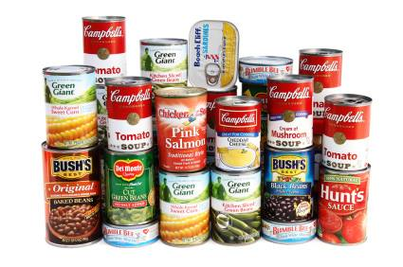
Nutrition Events
Collecting non-perishable food items in partnership with DECA to donate to Loudoun Hunger Relief
You can earn 1 hour per item (max of 2 hours)
Free Rice is also a great way to help the hunger crisis, while also earning hours

Slide 7
Videos
https://www.youtube.com/watch?v=1ZlYprqU2uY
https://www.youtube.com/watch?v=wkHG51Ovl6U

Slide 8
Contact Us
Email: bwunicef@gmail.com
Remind: Text @bwunicef to 81010
Website: http://briarwoodsunicef.weebly.com/

Slide 9
Next UNICEF Club Meeting: Friday, January 11th at 8:40 AM
This presentation can be found under the “Updates” tab on our website

