Slide 1
UNICEF Club Meeting
1/11/19
Child Trafficking
Officers: Sneha Gonuguntla, Smruti Shah, Sahil Gullapalli, Lauren Grant, and Aishu Rajubabu

Slide 2
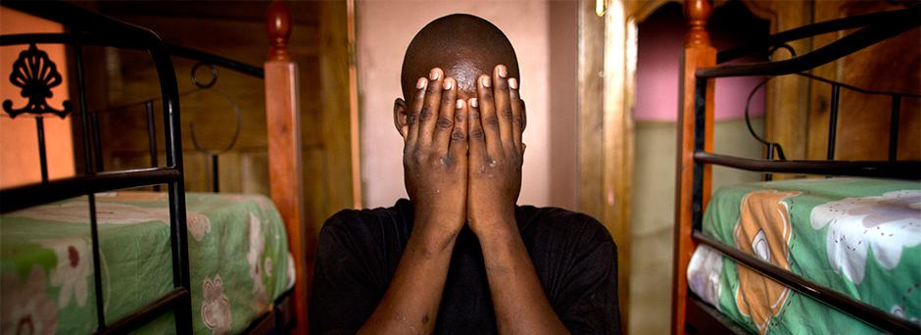
What is Child Trafficking?
Child Trafficking involves the recruitment, transportation, and harboring of a child for slavery, forced labor, and exploitation.
They may be forced to work in sweatshops, on construction sites or in houses as domestic servants; on the streets as child beggars, in wars as child soldiers, on farms, in traveling sales crews or in restaurants and hotels. Some children are even forced to work in brothels and strip clubs or for escort and massage services.

Slide 3
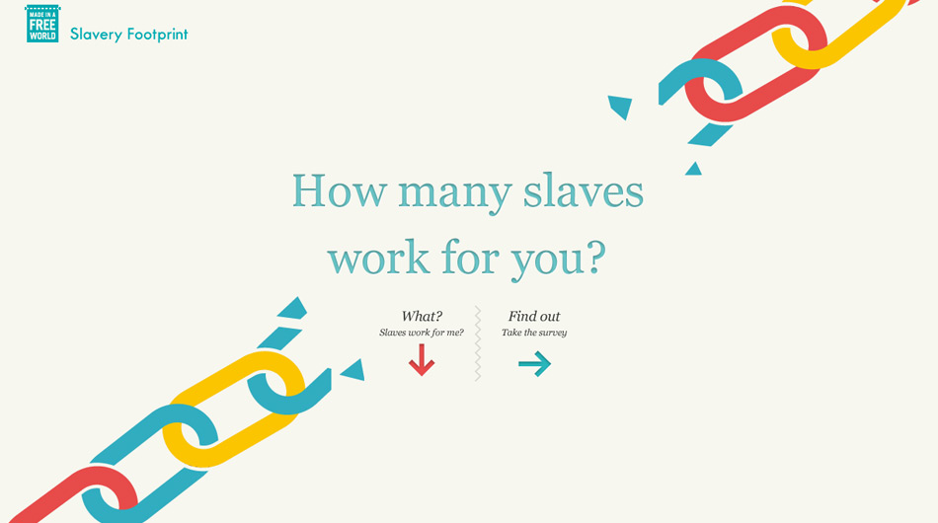
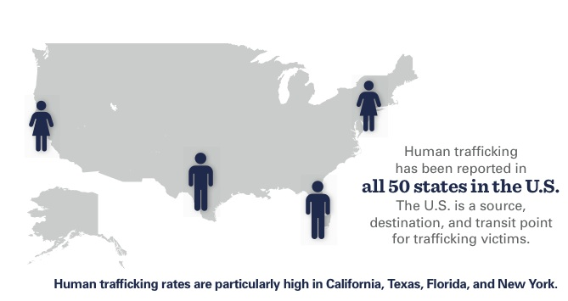
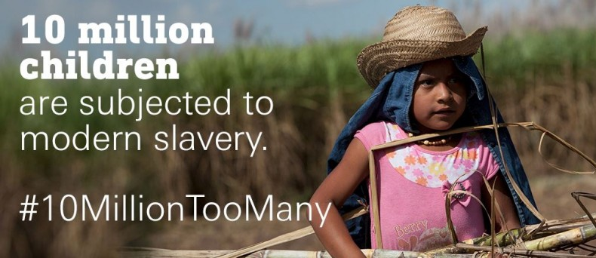
Child Trafficking Awareness
The International Labor Organization (ILO) estimates that there are about 10 million child trafficking victims worldwide.
Lessen your own slavery footprint. Whether you are at the mall, or shopping for groceries, take a second to verify that the products you buy were made by free adult workers.

Slide 4
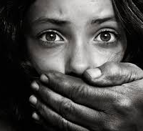
Child Trafficking Videos
https://www.youtube.com/watch?v=68X1_hKrxV0
https://www.youtube.com/watch?v=JyHsL5g0ugA&feature=youtu.be

Slide 5
Volunteer Service Hours
UNICEF Club Attendance
Requirement: 5 Hours by the end of the 1st Semester (January 17th), please send us an email with your hours
Email us ahead of time if you will be unable to attend a meeting
You can see your total hours/attendance on the BWHS UNICEF Club Weebly Website via this link: (https://briarwoodsunicef.weebly.com/hoursattendence.html)

Slide 6
Events
Advocate for UNICEF:
Each Petition = 1 Volunteer Service Hour
We will send the links via Remind/Email
Email us a screenshot of the confirmation link
https://www.unicefusa.org/help/advocate

Slide 7
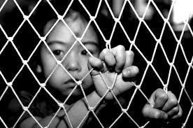
January Meeting In-Club Activity (Page 31)
Child Trafficking Worksheet
Work in groups of 4-5 people
Write group members names at the top of the worksheet
Turn in worksheet by the end of the meeting for 0.5 hour for each member
https://www.unicefusa.org/sites/default/files/6-8_Child_Trafficking_MS_2016.pdf

Slide 8
Contact Us
Email: bwunicef@gmail.com
Remind: Text @bwunicef to 81010
Website: http://briarwoodsunicef.weebly.com/

Slide 9
Next BWHS UNICEF Club Meeting: Friday, February 8th at 8:40 AM
This presentation can be found under the “Updates” tab on our website

